Slide 1
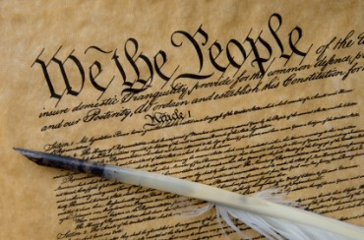
Locke III: The Establishment of Civil Government
Politics 2A
Dr Carl Knight, Lecturer in Political Theory

Slide 2

RECAP
As we’ve seen, in state of nature everyone has right to decide whether Law of Nature has been violated and to punish any violations of it (executive power)
Though this does not amount to a state of war, there are ‘inconveniences’ arising from dispersal of power
What is needed, then, is a government with the power to overcome these inconveniences

Slide 3
RATIONALE FOR COMMONWEALTH
It is the desire to protect their property that motivates people to form political society: ‘The great and chief end therefore, of Men’s uniting into Commonwealths, and putting themselves under Government, is the Preservation of their Property’ (§ 124)
Who would consent to this? Everyone or only those people with property?
Remember, however, the broad definition of property: ‘Lives, Liberties, and Estates’. All have property, as all have their life, and a measure of liberty.

Slide 4

THE ORIGINAL COMPACT
How is civil society created?
When everyone gives up their individual executive power we have the establishment of civil society via the social contract or ‘original compact’
‘there only, is political society where every one of the members hath quitted this natural power, resigned it up into the hands of the community’ (§ 87)
fair to everybody – all make the same sacrifice for the same benefits

Slide 5

UNANIMITY
Original compact requires consent of everyone involved: ‘men being, as has been said, by nature, all free, equal, and independent, no one can be put out of this estate, and subjected to the political power of another, without his own consent. The only way whereby any one divests himself of his natural liberty, and puts on the bonds of civil society, is by agreeing with other men to join and unite into a community … This any number of men may do, because it injures not the freedom of the rest’ (§ 95)

Slide 6

MAJORITARIANISM
‘every man, by consenting with others to make one body politic under one government, puts himself under an obligation, to every one of that society, to submit to the determination of the majority, and to be concluded by it; or else this original compact, whereby he with others incorporates into one society, would signify nothing, and be no compact, if he be left free, and under no other ties than he was in before in the state of nature’ (§ 97)

Slide 7

EXPRESS CONSENT
Required by original compact: ‘we see, that foreigners, by living all their lives under another government ... do not thereby come to be subjects or members of that commonwealth. Nothing can make any man so, but his actually entering into it by positive engagement, and express promise and compact. This is that, which I think, concerning the beginning of political societies, and that consent which makes any one a member of any commonwealth’. (§ 122)

Slide 8

TACIT CONSENT
Applies after commonwealth is formed: ‘every man that hath any possession or enjoyment of any part of the dominions of any government doth thereby give his tacit consent, and is as far forth obliged to obedience to the laws of government, during such enjoyment, as any one under it, whether this his possession be of land to him and his heirs for ever, or a lodging only for a week…it reaches as far as the very being of anyone within the territories of that government’ (§ 119)

Slide 9
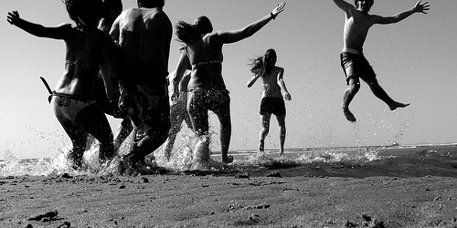
CIVIL FREEDOM
Freedom in society is therefore more restricted than freedom in the state of nature. You cannot do just anything in accord with your own judgment and the law of nature.
‘The Liberty of Man, in Society, is to be under no other Legislative Power, but that established, by consent, in the Common-wealth, nor under the dominion of any Will, or restraint of any Law, but what the Legislative shall enact, according to the Trust put in it’ (II § 22).

Slide 10

ACTIVITY
Does Locke provide a plausible justification for majority rule?
You may wish to discuss Locke’s arguments about:
Reasons for entering the commonwealth (inconveniences of SoN, property protection)
The original compact (giving up executive power)
Initial unanimity and express consent
Later majoritarianism, tacit consent & civil freedom

Slide 11
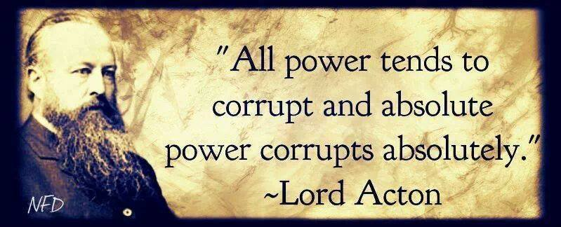
AGAINST ABSOLUTE POWER
People won’t accept absolute sovereign
‘as if when men quitting the state of nature entered into society, they agreed that all of them but one, should be under the restraint of laws, but that he should still retain all the liberty of the state of nature, increased with power, and made licentious by impunity. This is to think that Men are so foolish that they take care to avoid what mischiefs may be done to them by Pole-cats, or Foxes, but are content, nay think it safety, to be devoured by Lions’ (§ 93)

Slide 12

AGAINST COMMONWEALTH ACQUISITION
Individuals are free and equal - therefore government must be based on consent. There can be no right to commonwealth by acquisition as in Hobbes.
‘Should a robber break into my house, and with a dagger at my throat, make me seal deeds to convey my estate to him, would this give him any just title? Just such a title by his sword, has an unjust conqueror, who forces me into submission’
Without consent the ruler is a tyrant, and is at war with his people

Slide 13

LIMITED GOVERNMENT
Unlike Hobbes, Locke binds the government to the original compact
Government is a fiduciary trust delegated by the people. It is bounded by the natural law.
Specifically, government power is ‘to be directed to no other end, but the Peace, Safety, and publick good of the People’ (§ 131). This largely consists in correcting the ‘inconveniences’ (i.e. protect property)

Slide 14
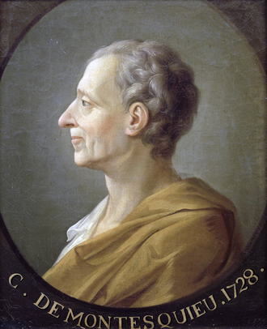
BRANCHES OF GOVERNMENT
One way govt is limited is via a separation of powers
Legislative branch, executive branch, ‘federative branch’ (foreign affairs/defence)
Contrast with Montesquieu’s legislative, executive, and judicial largely terminological - L’s fed similar to M’s exec, and L’s exec similar to M’s judicial
Influenced modern separation of powers but differs
Arrest, trial, and punishment all part of executive (L)

Slide 15
PEOPLE POWER
Locke’s thought is characterised by a fear that the power of government will fall into corrupt hands and be used against the people.
Government is restricted by a constitution. It’s power comes from law – if it breaks law, no power
Power delegated by the people and can be recovered
Breach of contract > no longer legitimate > removal
Consent to join a political community is distinct from consent to a particular government.

Slide 16

REBELLION
Rebelling against a government is not necessarily the end of the political community.
‘And thus the community perpetually retains a supreme power of saving themselves from the attempts and designs of any body, even of their legislators, whenever they shall be so foolish or so wicked as to lay and carry on designs against the liberties and properties of the subject’ (§ 149)
Right to rebellion limited – not every dispute – but only radical and long term abuse, agreed collectively

Slide 17
IS LOCKE A DEMOCRAT?
Locke defends the principle of majority rule. But how much direct input on decisions do people have?
Some (e.g. Seliger) emphasize importance of creation of commonwealth, arguing that this establishes a constitution that binds later decisions
Others (e.g. Kendall) interpret him as thoroughly majoritarian with limited constitutional constraints
Locke is not very specific on who gets to hold political rights. Bourgeoisie only (J Cohen)? All taxpayers (Hughes)? Early feminist (Waldron)?

Slide 18

SECOND TREATISE REVIEW
Law of nature, state of nature, property
Contract, consent, limited government, rebellion

Slide 19
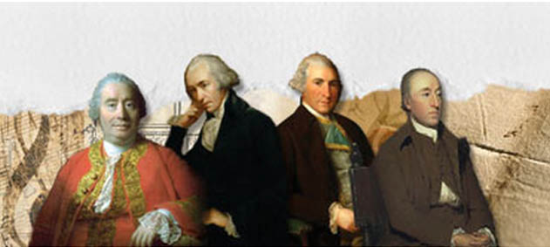
Next Lecture: The Scottish Enlightenment

